Slide 1
Yale
UNIVERSITY

Slide 2
Presented by:
统计10-徐玖堃
        丁洋
        刘畅
会计10-柴晨朔

Slide 3



©Yale University
YALE University
an AMERICAN private IVY LEAGUE
RESEARCH university LOCATED in NEW HAVEN
Founded in 1701 in the Colony of Connecticut, the university is the third-oldest institution of higher education in the United States.
Start Here
Introduction
Campus Life
Alumni
History
Academics
Application
Presented by:
Maple . Anna . Aria . Jacky

Slide 4
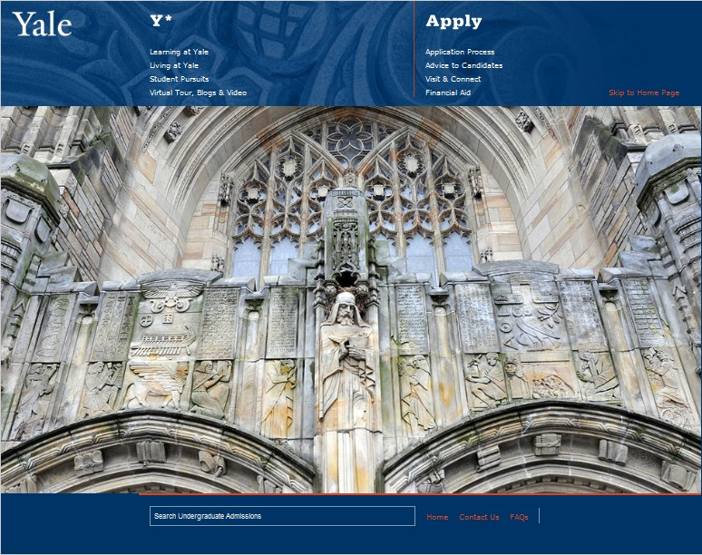
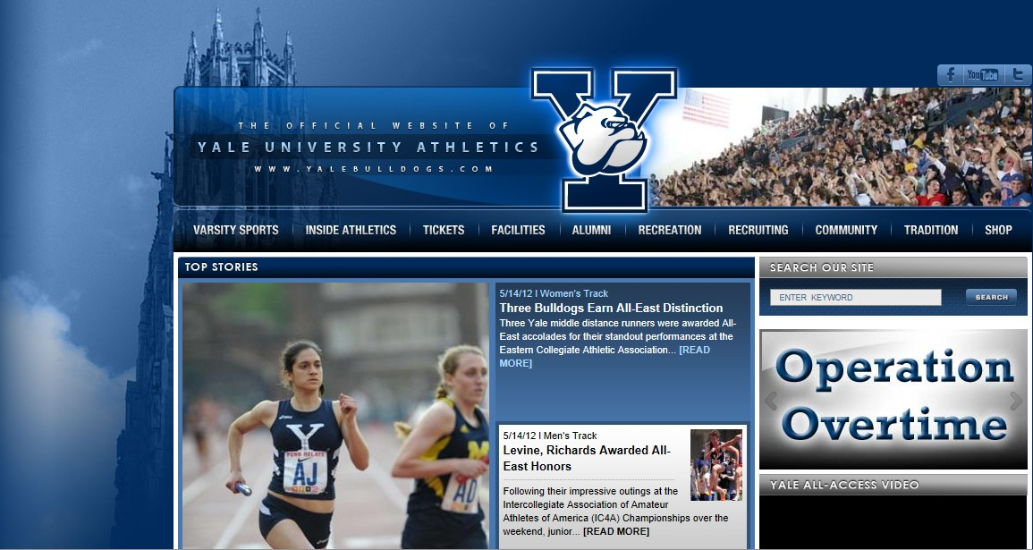
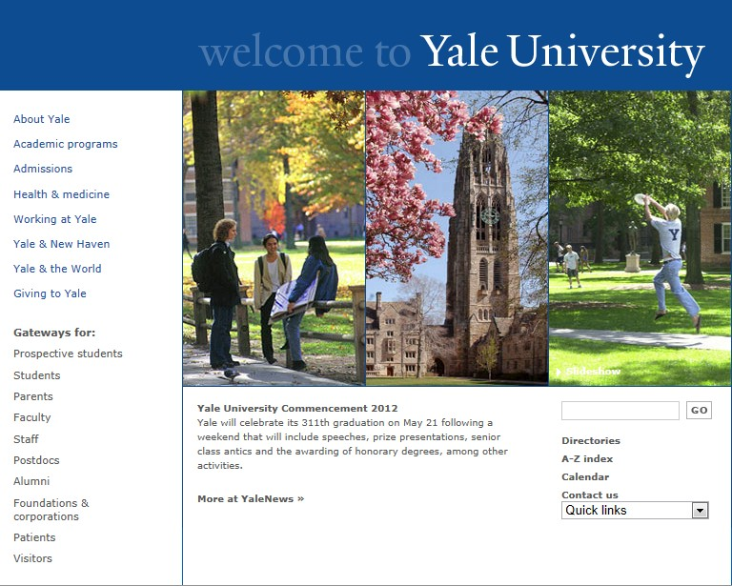
1
YALE WEBSITES
YALEUniversity
Presented by:
Maple . Anna . Aria . Jacky
LIGHT AND TRUTH

Slide 5


2
YALE BLUE
Since the 1850's, Yale Crew has rowed in blue uniforms, and in 1894, blue was officially adopted as Yale's color. In 2005, University Printer John Gambell was asked to standardize the color.
Hex triplet : #0F4D92
RGB(r, g, b) : (15, 77, 146)
Light and Truth is Yale's source for intellectually driven, rational conservative thought. Articles range from considerations on the political, to the philosophical, to the Yale community and current affairs.
LIGHT and TRUTH
School MOTTO
YALEUniversity
Presented by:
Maple . Anna . Aria . Jacky
LIGHT AND TRUTH

Slide 6

3
YALE IN BRIEF
Several data
Undergraduate students* | 5,279
Graduate and professional students* | 6,381
International students* | 1,987
Faculty* | 3,810
Staff* | 9,085
International scholars* | 2,065
Living alumni | 167,350
Library holdings | 12.7 million volumes
Varsity athletic teams | 35
Total number of buildings | 439
Endowment | $16.5 billion
Operating budget* | $2.57 billion
For more information
please visit the official website:
www.yale.edu
YALEUniversity
Presented by:
Maple . Anna . Aria . Jacky
LIGHT AND TRUTH

Slide 7
4
YALE HISTORY
In 1640s, colonial clergymen led an effort to establish a college in New Haven to preserve the tradition of European liberal education in the New World.
in 1701, the charter was granted for a school “wherein Youth may be instructed in the Arts and Sciences through the blessing of Almighty God may be fitted for Publick employment both in Church and Civil State.”
In 1718 the school was renamed “Yale College” in gratitude to the Welsh merchant Elihu Yale, who had donated the proceeds from the sale of nine bales of goods together with 417 books and a portrait of King George I.
In the 19th and 20th centuries, the establishment of the graduate and professional schools that would make Yale a true university.
In the 1830s, International students have made their way to Yale, the first Latin American student enrolled.
In 1850,the first Chinese citizen to earn a degree at a Western college or university came to Yale.
In 1869, the University began admitting women students at the graduate level, and in 1969 as undergraduates.
Beginning in the early 1930s, Yale College was transformed, by the establishment of residential colleges.
YALEUniversity
Presented by:
Maple . Anna . Aria . Jacky
LIGHT AND TRUTH

Slide 8
5
SCHOOL HISTORY
Time | The Schools were chartered
1810 | The School of Medicine
1822 | the Divinity School
1824 | the Law School
1847 | the Graduate School of Arts and Sciences
1869 | the school of Art
1894 | the school of Music
1900 | the school of Forestry & Environmental Studies
1923 | the school of Nursing
1955 | the school of Drama
1972 | the school of Architecture
1974 | the school of Management
YALEUniversity
Presented by:
Maple . Anna . Aria . Jacky
LIGHT AND TRUTH

Slide 9


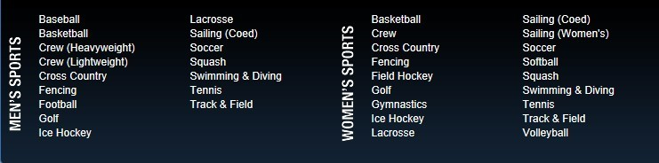
6
YALE SPORTS
Ivy league sports
National Collegiate Athletic Association
Varsity Sports:
YALEUniversity
Presented by:
Maple . Anna . Aria . Jacky
LIGHT AND TRUTH

Slide 10
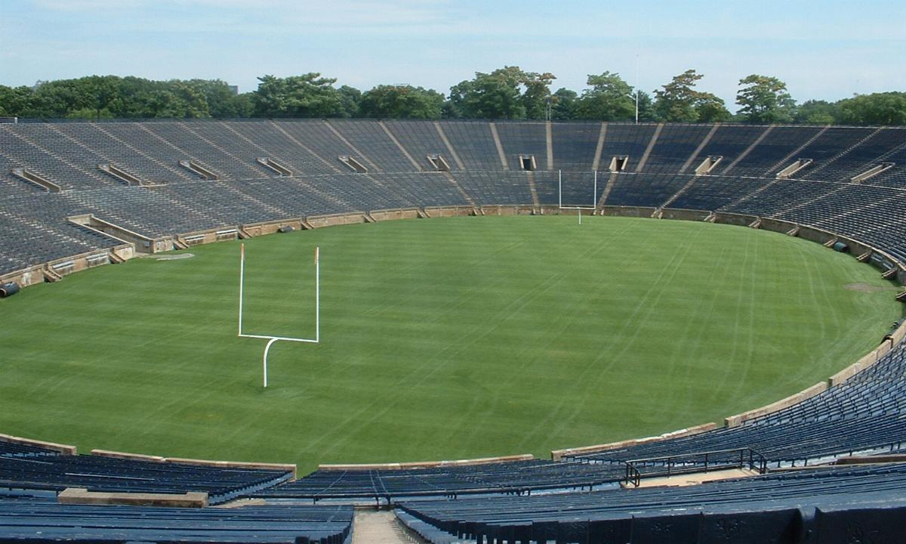
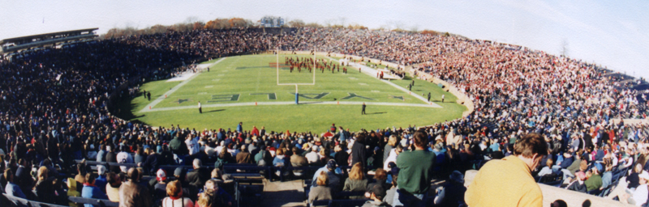
7
YALE BOWL
The historic Yale Bowl is one of the true treasures in American sports. It was the first stadium with seating that completely surrounded the field when it opened on Nov. 21, 1914, for the Yale-Harvard game.
Restoration of the famous Yale Bowl began in Spring 2005. The first phase included the installation of an iron picket fence with brick columns, the rebuilding of interior and exterior walls, the repair or replacement of 17 miles of wood seats, and upgrades to all drainage and utilities. Its current seating capacity is 61,446 and every seat has an unobstructed view of the playing field.
YALEUniversity
Presented by:
Maple . Anna . Aria . Jacky
LIGHT AND TRUTH

Slide 11
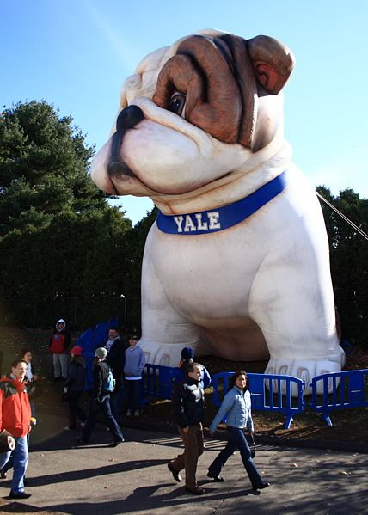


8
HANDSOME DAN
The mascot of Yale is a bulldog called Handsome Dan. The tradition was established by a young gentleman from Victorian England, who attended Yale in the 1890's.
Yale was the first university in the United States to adopt a mascot, and to this date, none is better known than Handsome Dan.
Bulldog, Bulldog, Bow Wow Wow!!!
Handsome Dan XVII
2007 ～ present
The official website of
Yale University Athletics:
www.yalebulldogs.com
YALEUniversity
Presented by:
Maple . Anna . Aria . Jacky
LIGHT AND TRUTH

Slide 12
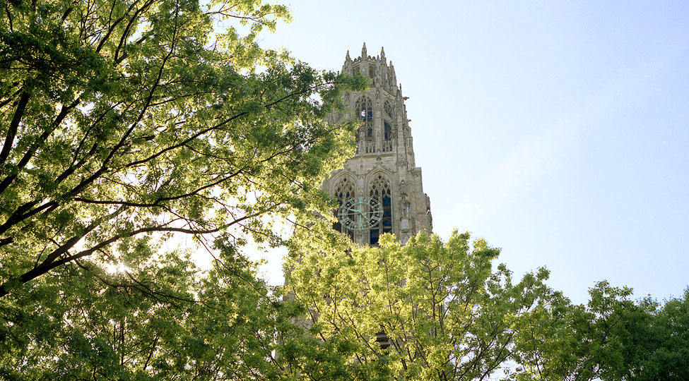
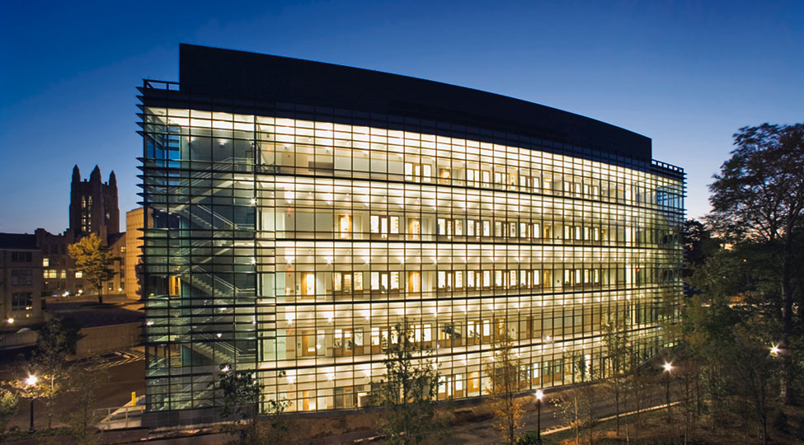
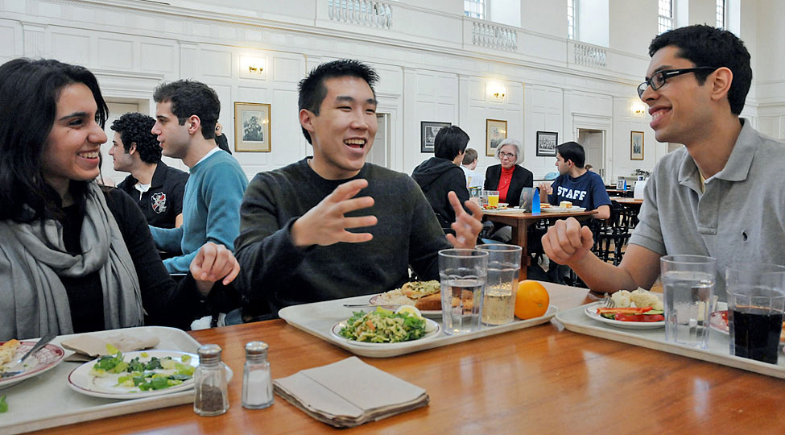
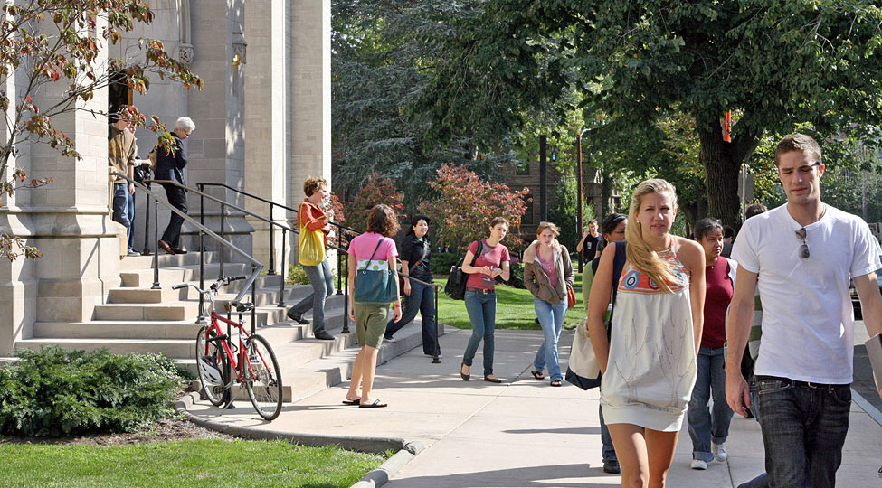
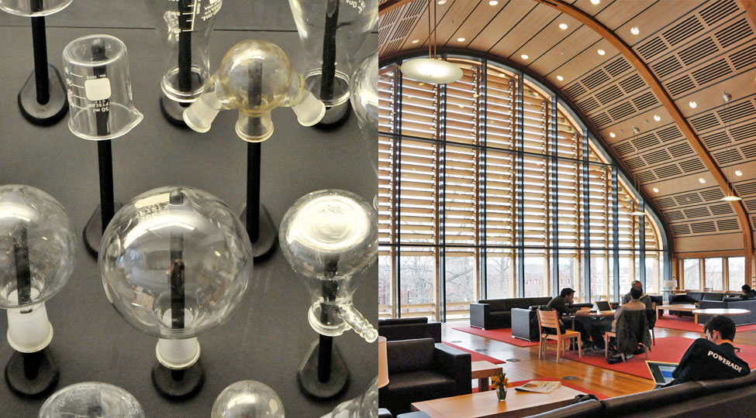
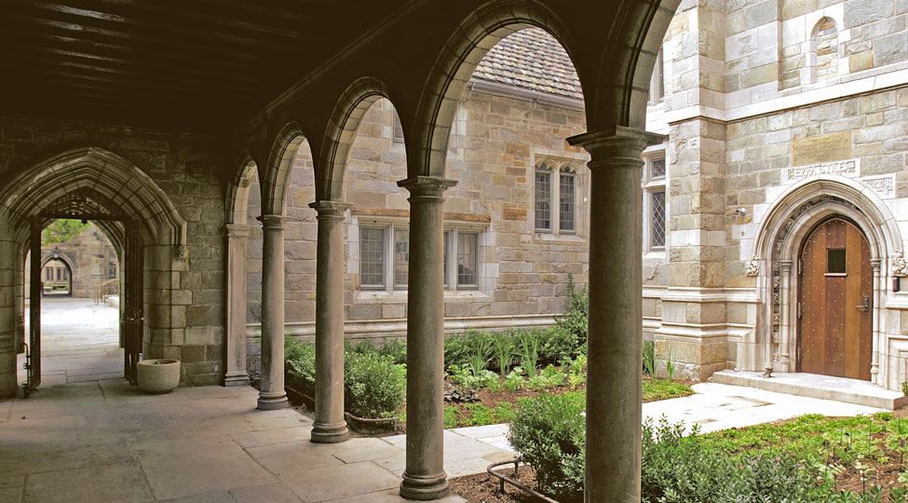

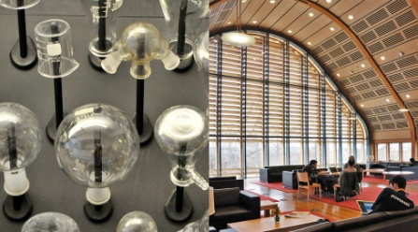


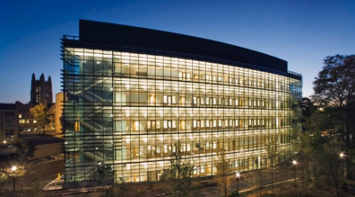
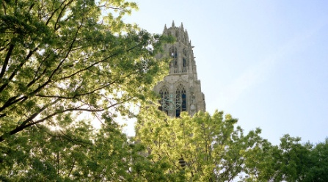
9
LIFE IN YALE
Campus Map
arches
chem-kroon
crowd
diners
engineering
harkness
YALEUniversity
Presented by:
Maple . Anna . Aria . Jacky
LIGHT AND TRUTH

Slide 13
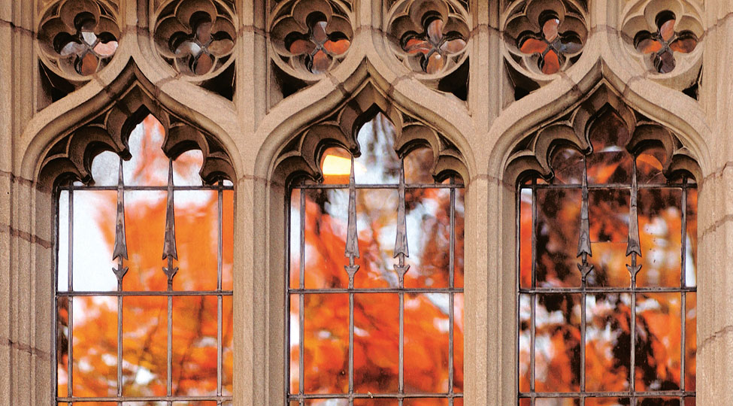
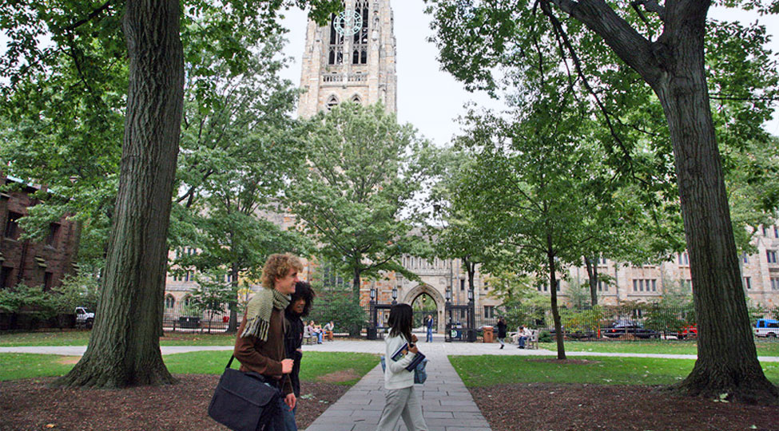
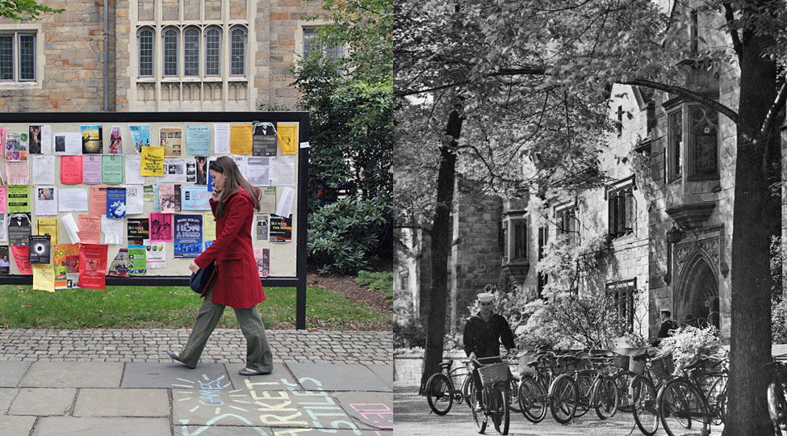
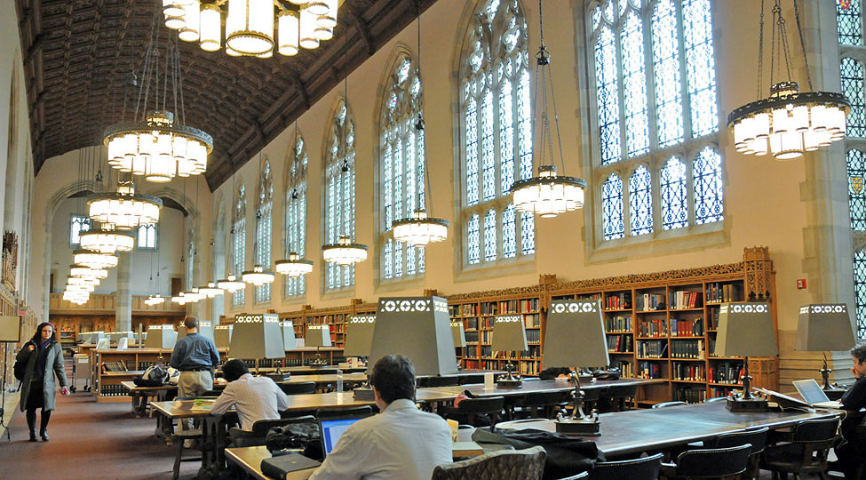
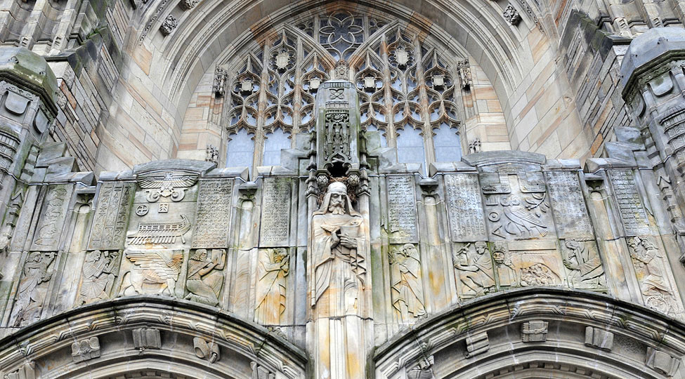
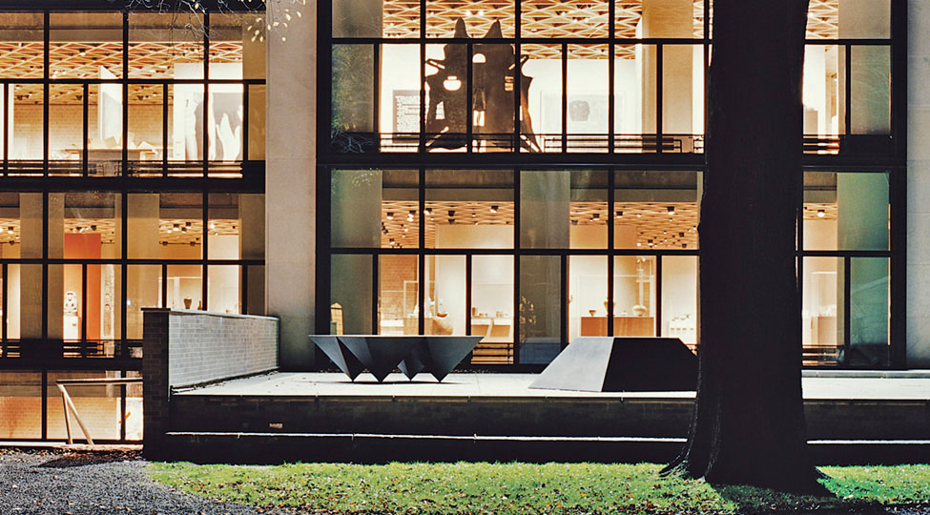



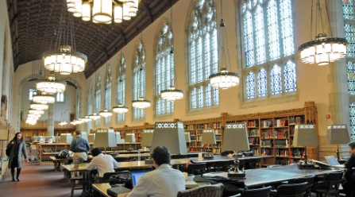
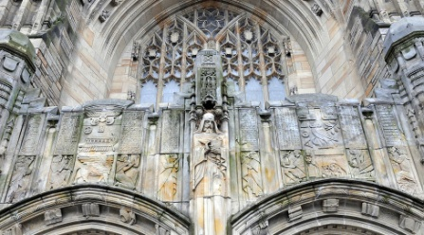

10
LIFE IN YALE
Virtual Tour
windows
walkers-harkness
walker-bicycle
sterling-interior
sterling-entrance
kahn
YALEUniversity
Presented by:
Maple . Anna . Aria . Jacky
LIGHT AND TRUTH

Slide 14
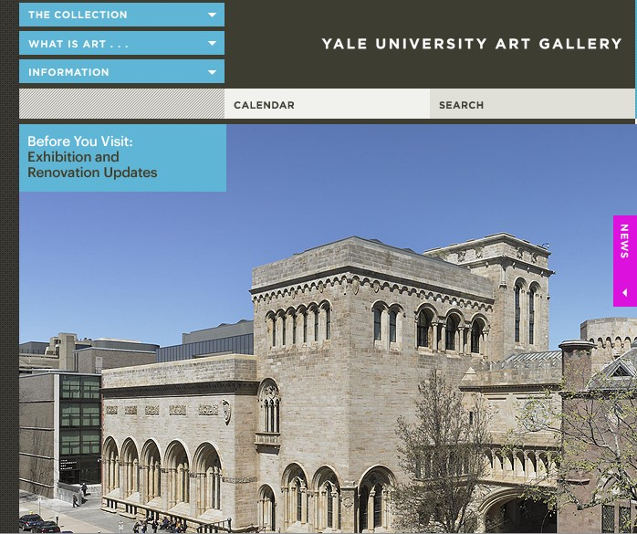
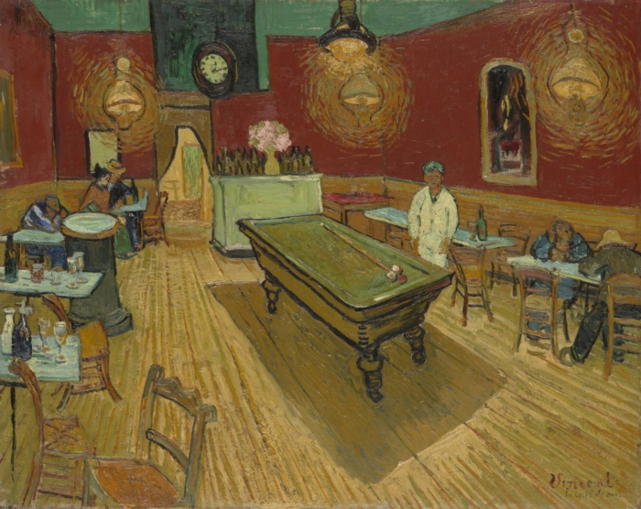
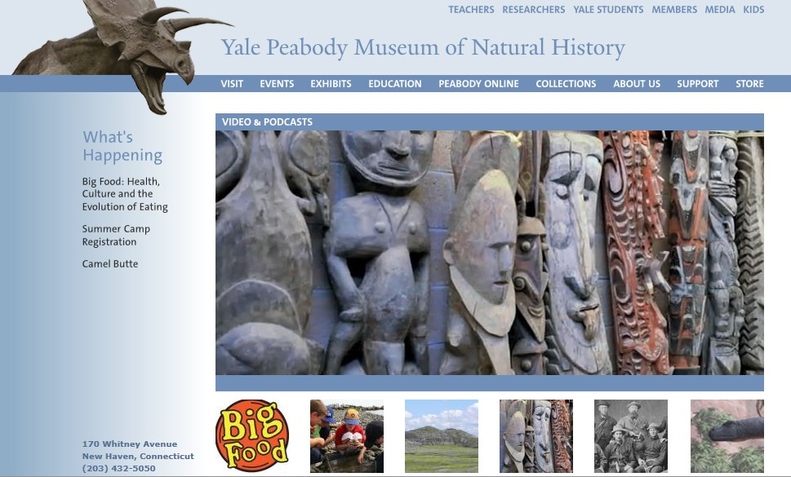
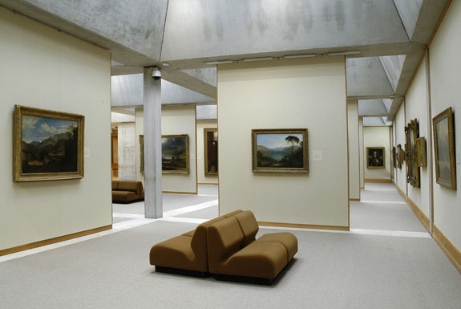
11
ART COLLECTIONS
The Night Cafe
YALEUniversity
Presented by:
Maple . Anna . Aria . Jacky
LIGHT AND TRUTH
Notes:
Vincent van Gogh

Slide 15
12
STUDENT ORGANIZATIONS
There are a number of student organizations at Yale University.
The Yale Political Union, the oldest student political organization in the United States, is often the largest organization on campus, and is advised by alumni political leaders such as John Kerry and George Pataki.
The university features a variety of student journals, magazines, and newspapers. The latter category includes the Yale Daily News, which was first published in 1878 and is the oldest daily college newspaper in the United States.
The campus also includes several fraternities and sororities.
YALEUniversity
Presented by:
Maple . Anna . Aria . Jacky
LIGHT AND TRUTH

Slide 16
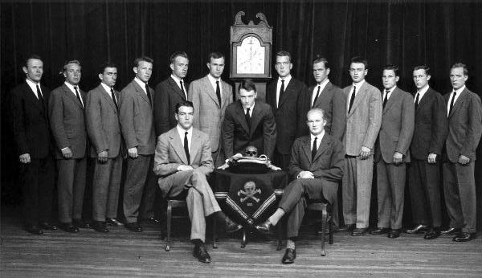
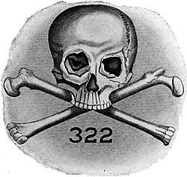
13
THE SKULLS
. Skull and Bones . The Order of Death . The Order .
. Cooperation Star . The Eulogian Club . Lodge 322 .
Skull and Bones is an undergraduate senior or secret society at Yale University, New Haven, Connecticut. It is a traditional peer society to Scroll and Key and Wolf's Head, as the three senior class "landed societies" at Yale.
Tapping :
Skull and Bones selects new members every spring as part of Yale University's "Tap Day", and has done so since 1879.[ Recent Tap Days were held on April 20, 2009, and April 15, 2010. Every year, Skull and Bones selects fifteen men and women of the junior class to join the society. Skull and Bones traditionally "tapped" those that it viewed as campus leaders and other notable figures for its membership. The Tapping ceremony has always been a public event at Yale.
YALEUniversity
Presented by:
Maple . Anna . Aria . Jacky
LIGHT AND TRUTH

Slide 17
14
YALE ACADEMICS
The university is one of only seven institutions of higher education in the world that is need blind and full-need to all of its applicants, including international students.
Through its program of need-based financial aid, Yale commits to meet the full demonstrated financial need of all applicants, and more than 50% of Yale students receive financial assistance. Most financial aid is in the form of grants and scholarships that do not need to be paid back to the university, and the average scholarship for the 2011–2012 school year was $35,400. More than 750 students in Yale College are expected to have $0 parental contribution.
YALEUniversity
Presented by:
Maple . Anna . Aria . Jacky
LIGHT AND TRUTH

Slide 18
15
ACADEMIC OFFERINGS
School of Management
    Department of Statistics
  Economics Department
YALEUniversity
Presented by:
Maple . Anna . Aria . Jacky
LIGHT AND TRUTH

Slide 19
16
School of MANAGEMENT
--- Our mission is to educate leaders for business and society.
The doctoral program is taught by the faculty of the Yale School of Management and is intended for students who plan scholarly careers involving research and teaching in management. The program is small and admits only a few highly qualified students each year. Currently, specialization is offered in the management fields of accounting, financial economics, marketing, and organizations and management.
Management Ph.D. students take a variety of courses offered by the Yale Graduate School, e.g., courses offered by the Economics, Statistics, Psychology and Sociology departments as well as the Yale Law School. They also take specialized courses in their area of interest. These specialized courses (e.g., Seminar in Accounting Research, Experimental Economics, Financial Economics, Corporate Finance and Market Microstructure, Analytical Methods in Marketing, Behavioral Decision Making, Organizations & Management : Inside Organizations and Organizations & Management : Organizations and the Environment) are taught by the faculty of the Yale School of Management.
YALEUniversity
Presented by:
Maple . Anna . Aria . Jacky
LIGHT AND TRUTH

Slide 20
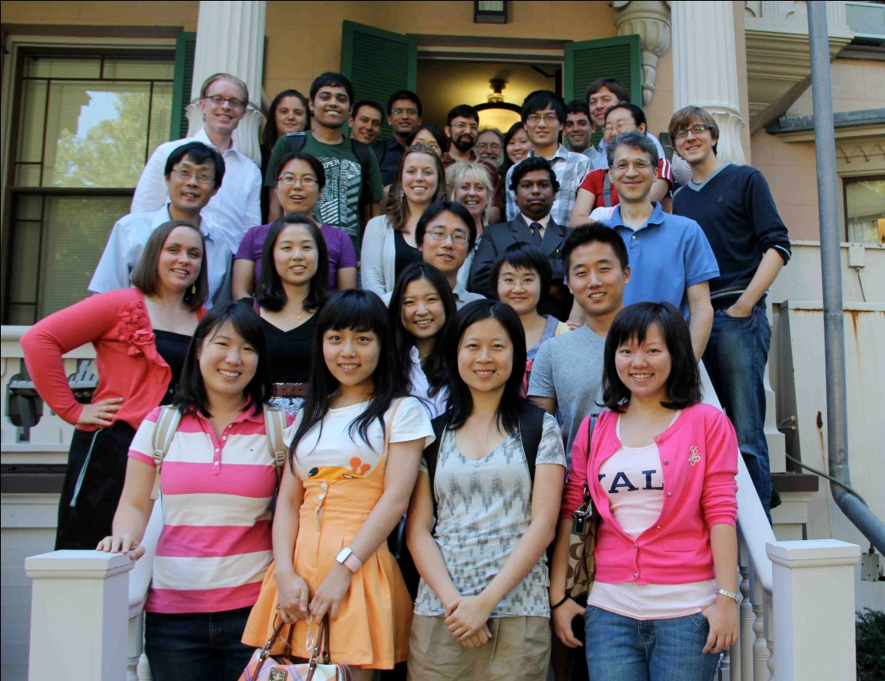
17
Department of STATISTICS
The Department of Statistics at Yale University consists of 8 faculty members, 3 staff, and 22 graduate students. They offer M.A. and Ph.D. programs, as well as an undergraduate major in Statistics.
They have active research programs in statistical information theory, statistical genetics and bioinformatics, bayesian methods, statistical computing, graphical methods, model selection, asymptotics, and other topics.
YALEUniversity
Presented by:
Maple . Anna . Aria . Jacky
LIGHT AND TRUTH

Slide 21
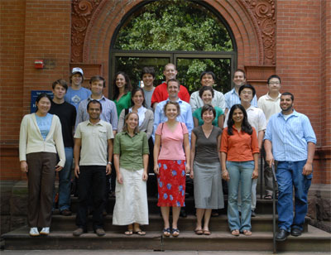
18
ECONOMICS Department
Yale's Economics Department offers a challenging and rigorous academic program, a distinguished and accessible faculty, and a friendly, supportive environment for study.
Our faculty covers a broad range of research and teaching interests. Courses and seminars span the whole spectrum of economics: from the mathematics of general equilibrium theory to economic history; from statistical and econometric methodology to its applications in macro economics, labor economics and demography; from macroeconomic policy to antitrust and environmental regulation; from the United States and developed economies to the developing nations of Latin America, Asia and Africa; from international trade and finance to the theory of public choice. Whatever your interest, the chances are that you will find someone on the faculty to guide you, if not in a regularly offered course or seminar or workshop, then in a reading and research course tailored to your needs, and finally in your Ph.D. Dissertation research.
YALEUniversity
Presented by:
Maple . Anna . Aria . Jacky
LIGHT AND TRUTH

Slide 22
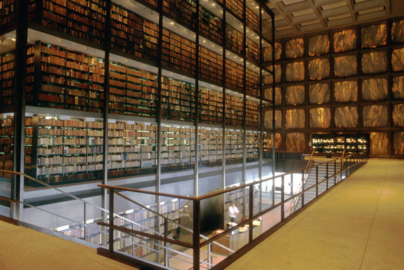
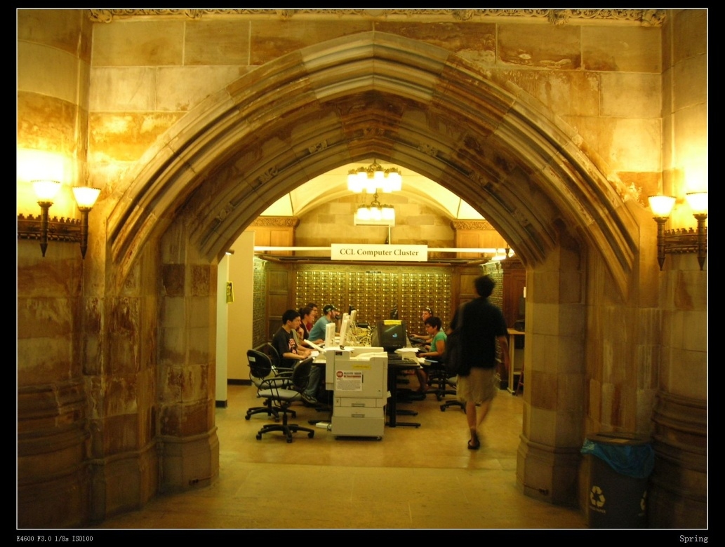
19
YALE LIBRARY
Yale University Library, which holds over 12 million volumes, is the second-largest university collection in the United States. The main library, Sterling Memorial Library, contains about four million volumes, and other holdings are dispersed at subject libraries.
Rare books are found in a number of Yale collections. The Beinecke Rare Book Library has a large collection of rare books and manuscripts. The Harvey Cushing/John Hay Whitney Medical Library includes important historical medical texts, including an impressive collection of rare books, as well as historical medical instruments.
YALEUniversity
Presented by:
Maple . Anna . Aria . Jacky
LIGHT AND TRUTH

Slide 23
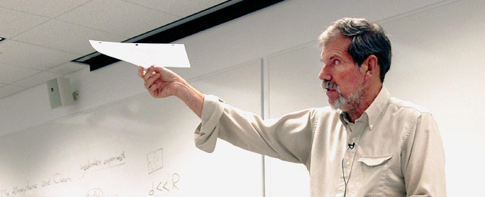
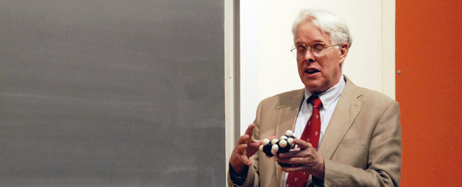
20
OPEN COURSES
Open Yale Courses provides free and open access to a selection of introductory courses taught by distinguished teachers and scholars at Yale University. The aim of the project is to expand access to educational materials for all who wish to learn.
Each course includes a full set of class lectures produced in high-quality video accompanied by such other course materials as syllabi, suggested readings, exams, and problem sets. The lectures are available as downloadable videos, and an audio-only version is also offered. In addition, searchable transcripts of each lecture are provided.
The following courses are some of the famous ones:
· African American Studies · Chemistry · Ecology and Evolutionary Biology
· Economics · Environmental Studies · History of Art · Religious Studies
YALEUniversity
Presented by:
Maple . Anna . Aria . Jacky
LIGHT AND TRUTH

Slide 24
21
SUMMER SESSION
Statistics:
STAT S107 01 (30245)
Introduction to Statistics
Jonathan Reuning-Scherer
M-F 10.00-11.15
Summer 2012 SU 5B Session
Skills QR
Not Cr/D/F
An introduction to statistical reasoning. Topics include controlled experiments and observational studies; histograms and scatterplots, averages and standard deviations; measurement error, the normal approximation; correlation and regression; probability and chance variation; sampling, the Gallup Poll and Current Population Survey; tests of significance. Focus on understanding concepts rather than mathematical manipulation. No formal mathematical prerequisite. 1 Credit. Tuition $3,150.
YALEUniversity
Presented by:
Maple . Anna . Aria . Jacky
LIGHT AND TRUTH

Slide 25

22
SUMMER SESSION
Economics:
ECON S115 01 (30066)
Introduction to Microeconomics
Tolga Koker
TTh 1.00-4.15
Summer 2012 SU Session
Skills QR
Areas So
Not Cr/D/F
Introduction to the principles of microeconomics, supply and demand, consumer theory, and competitive markets. Applications to contemporary policy issues such as rent control, minimum wage, antitrust policy, pollution, and income inequality. For college students only. May not be taken after ECON 108 or 110. 1 Credit. Tuition: $3,150.
YALEUniversity
Presented by:
Maple . Anna . Aria . Jacky
LIGHT AND TRUTH

Slide 26
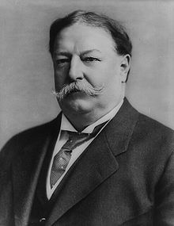
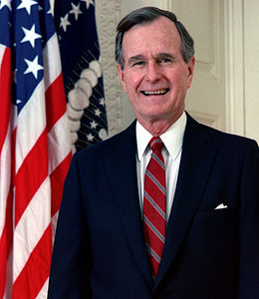
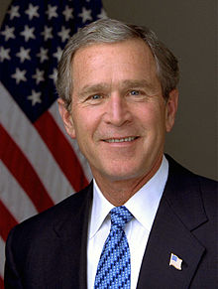
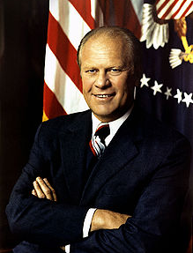
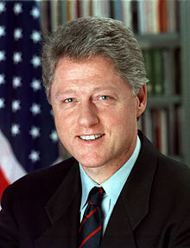
23
Alumni from YALE
5 US Presidents, 19 US Supreme Court Justices,
and several foreign heads of state
YALEUniversity
Presented by:
Maple . Anna . Aria . Jacky
LIGHT AND TRUTH

Slide 27
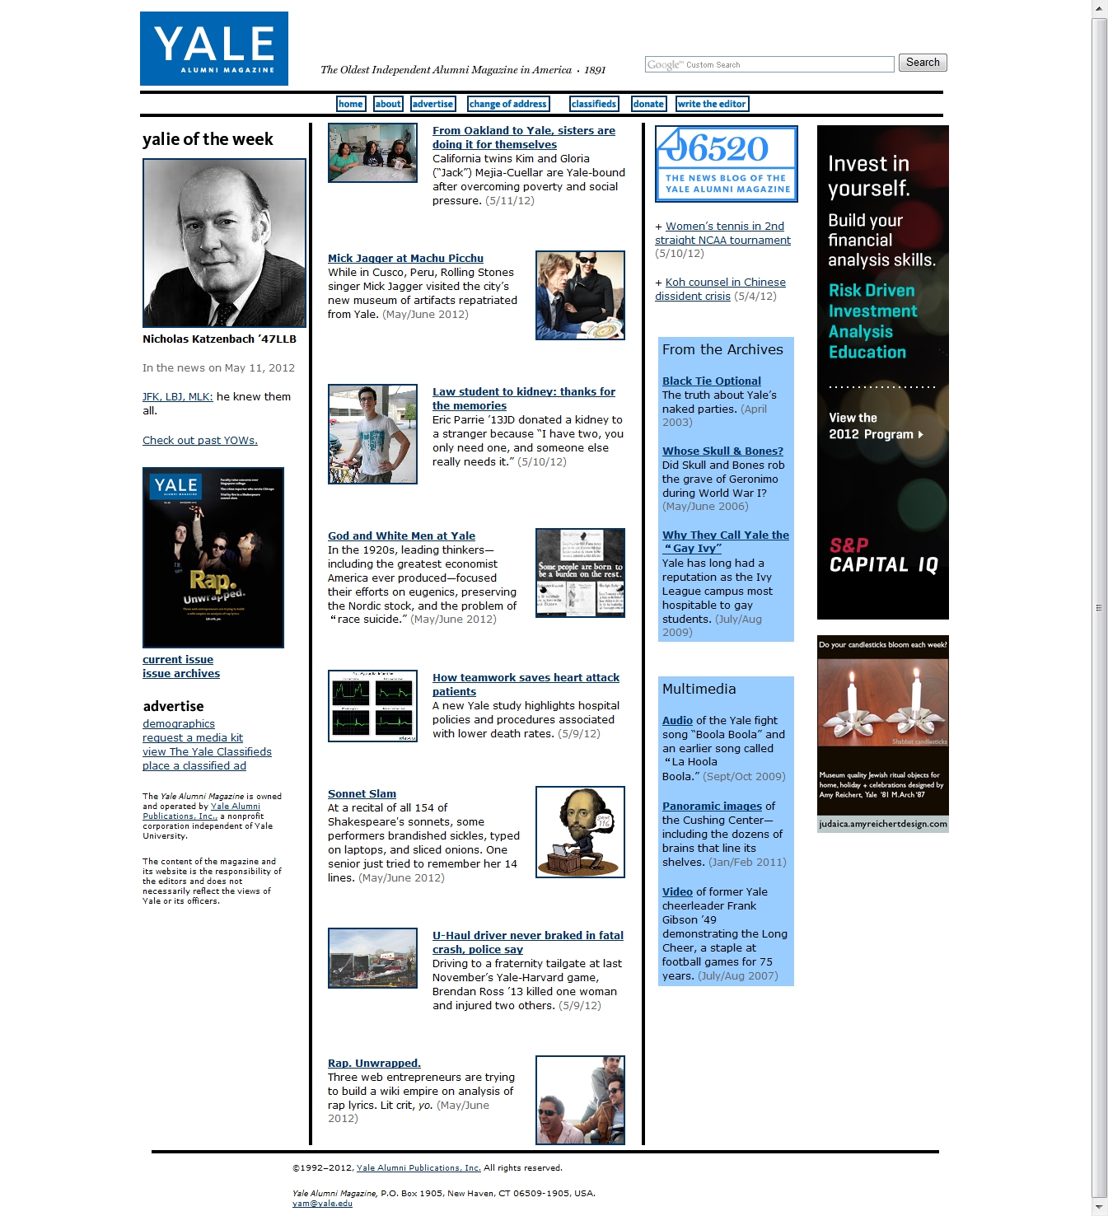
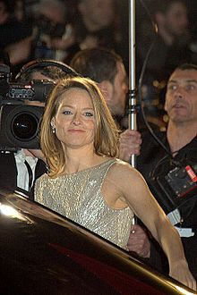
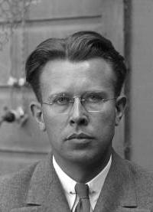
24
Alumni from YALE
5 US Presidents, 19 US Supreme Court Justices,
and several foreign heads of state
Jodie Foster
American actress,
film director & producer
Ernest Orlando Lawrence
American physicist
awarded the Nobel Prize in 1939
Yale Alumni Magazine
YALEUniversity
Presented by:
Maple . Anna . Aria . Jacky
LIGHT AND TRUTH

Slide 28
25
Apply to YALE
MBA Applications
Standard Qualification
All applicants to the Yale School of Management must take either the GMAT or the GRE. There is no minimum score to apply.
Although there are no minimum TOEFL, PTE Academic, and IELTS scores to apply, to be competitive, an applicant should have a TOEFL score of at least 100 on the Internet-based test, a PTE Academic score of at least 70, or an IELTS score of at least 7.
GMAT: 700 above TOFEL: 100 above
Average GPA: 3.8 above IELTS: 7 above
Expense (School of Manager)
Fee: about 40000 dollars one year
All Expense: about 75000 dollars one year
YALEUniversity
Presented by:
Maple . Anna . Aria . Jacky
LIGHT AND TRUTH

Slide 29
26
CHINESE Applicants
Year | Application Received | Number of People Enrolled | Acceptance rates
2005 | 19451 | 1880 | 9.7%
2006 | 21101 | 1878 | 8.9%
2007 | 19323 | 1911 | 9.9%
2008 | 22817 | 1952 | 8.6%
Year | Number of Chinese Students
2006 | 236
2007 | 196
2008 | 216
2009 | 255
YALEUniversity
Presented by:
Maple . Anna . Aria . Jacky
LIGHT AND TRUTH

Slide 30
27
SEVERAL TIPS
▪ Please use your full legal name on all admissions document. Remember to use your full legal name when you take the standardized tests as well.
▪ Strongly encourage to apply online.
▪ You are asked to write two essays on topics of your choice and to write about your extracurricular activities in the spaces provided. Write openly and honestly about activities, interests, or experiences that have been meaningful to you.
▪ Bringing Your Application to Life
YALEUniversity
Presented by:
Maple . Anna . Aria . Jacky
LIGHT AND TRUTH

Slide 31
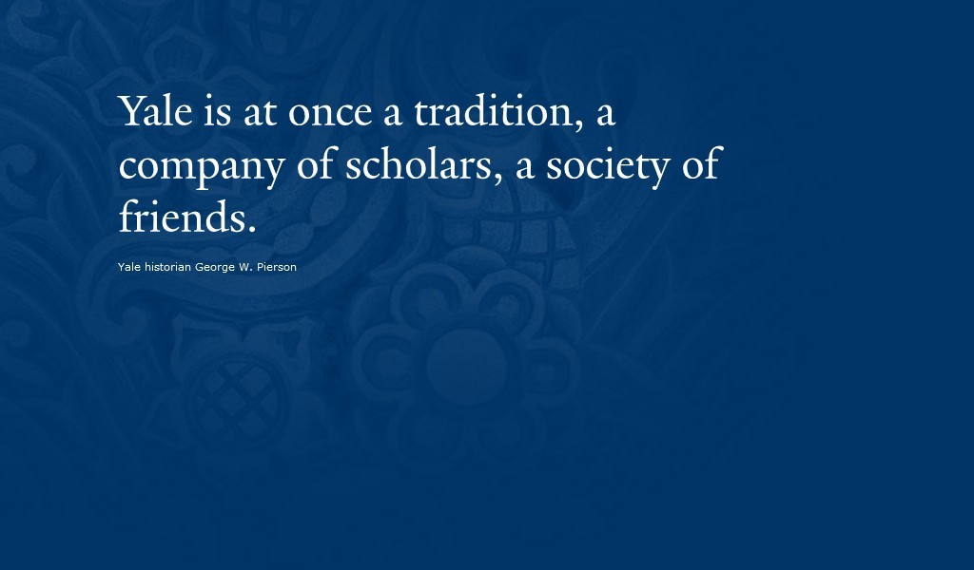
28
YALEUniversity
Presented by:
Maple . Anna . Aria . Jacky
LIGHT AND TRUTH

Slide 32
LIGHT & TRUTH
THANKS FOR
From Yale University
your attention.

